Slide 1


Introduction to Molecular Biology
Lab 9
Dr. Rawa Abdul Redha Aziz
Ph.D Antibiotics/ Molecular biology

Slide 2
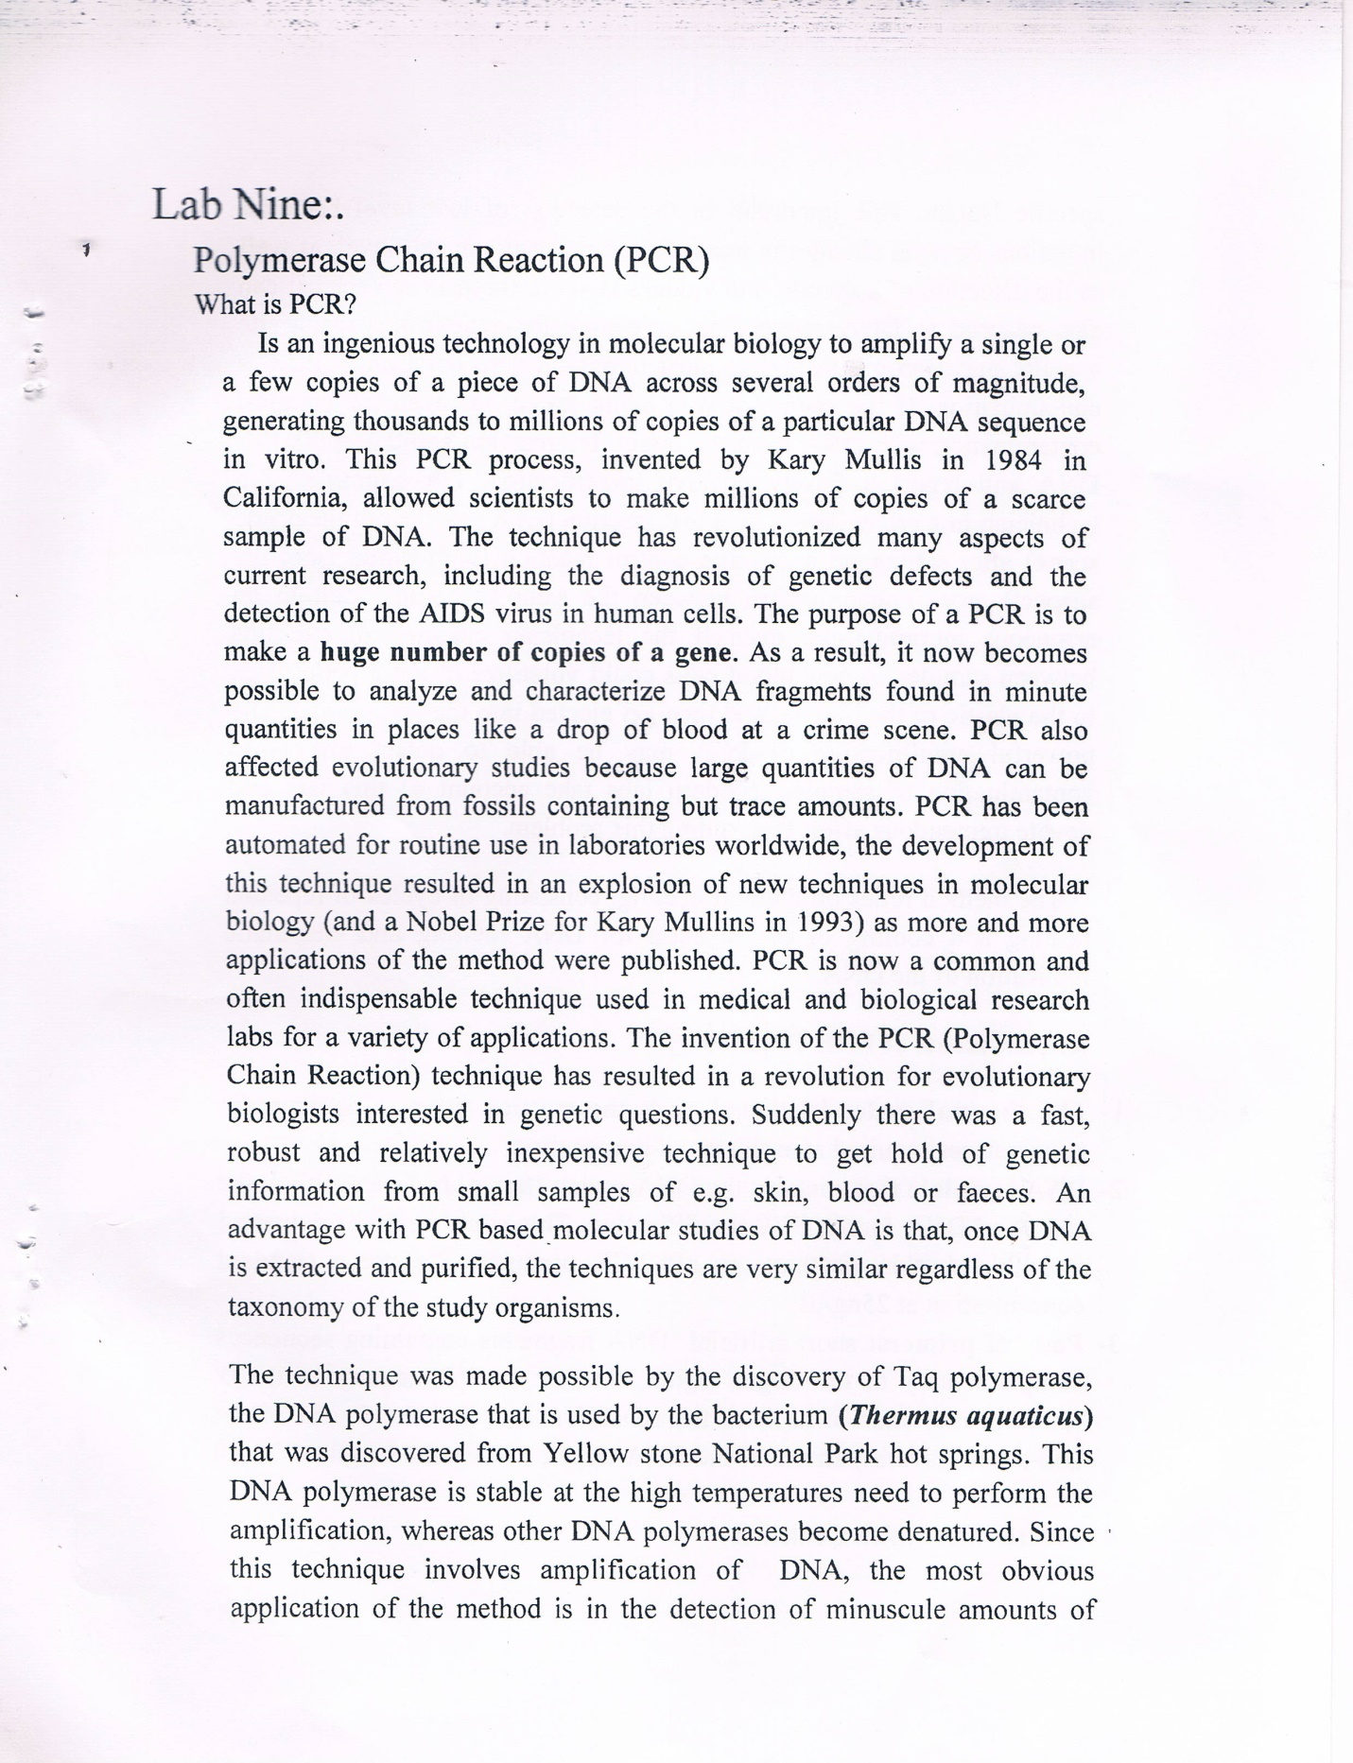

Slide 4
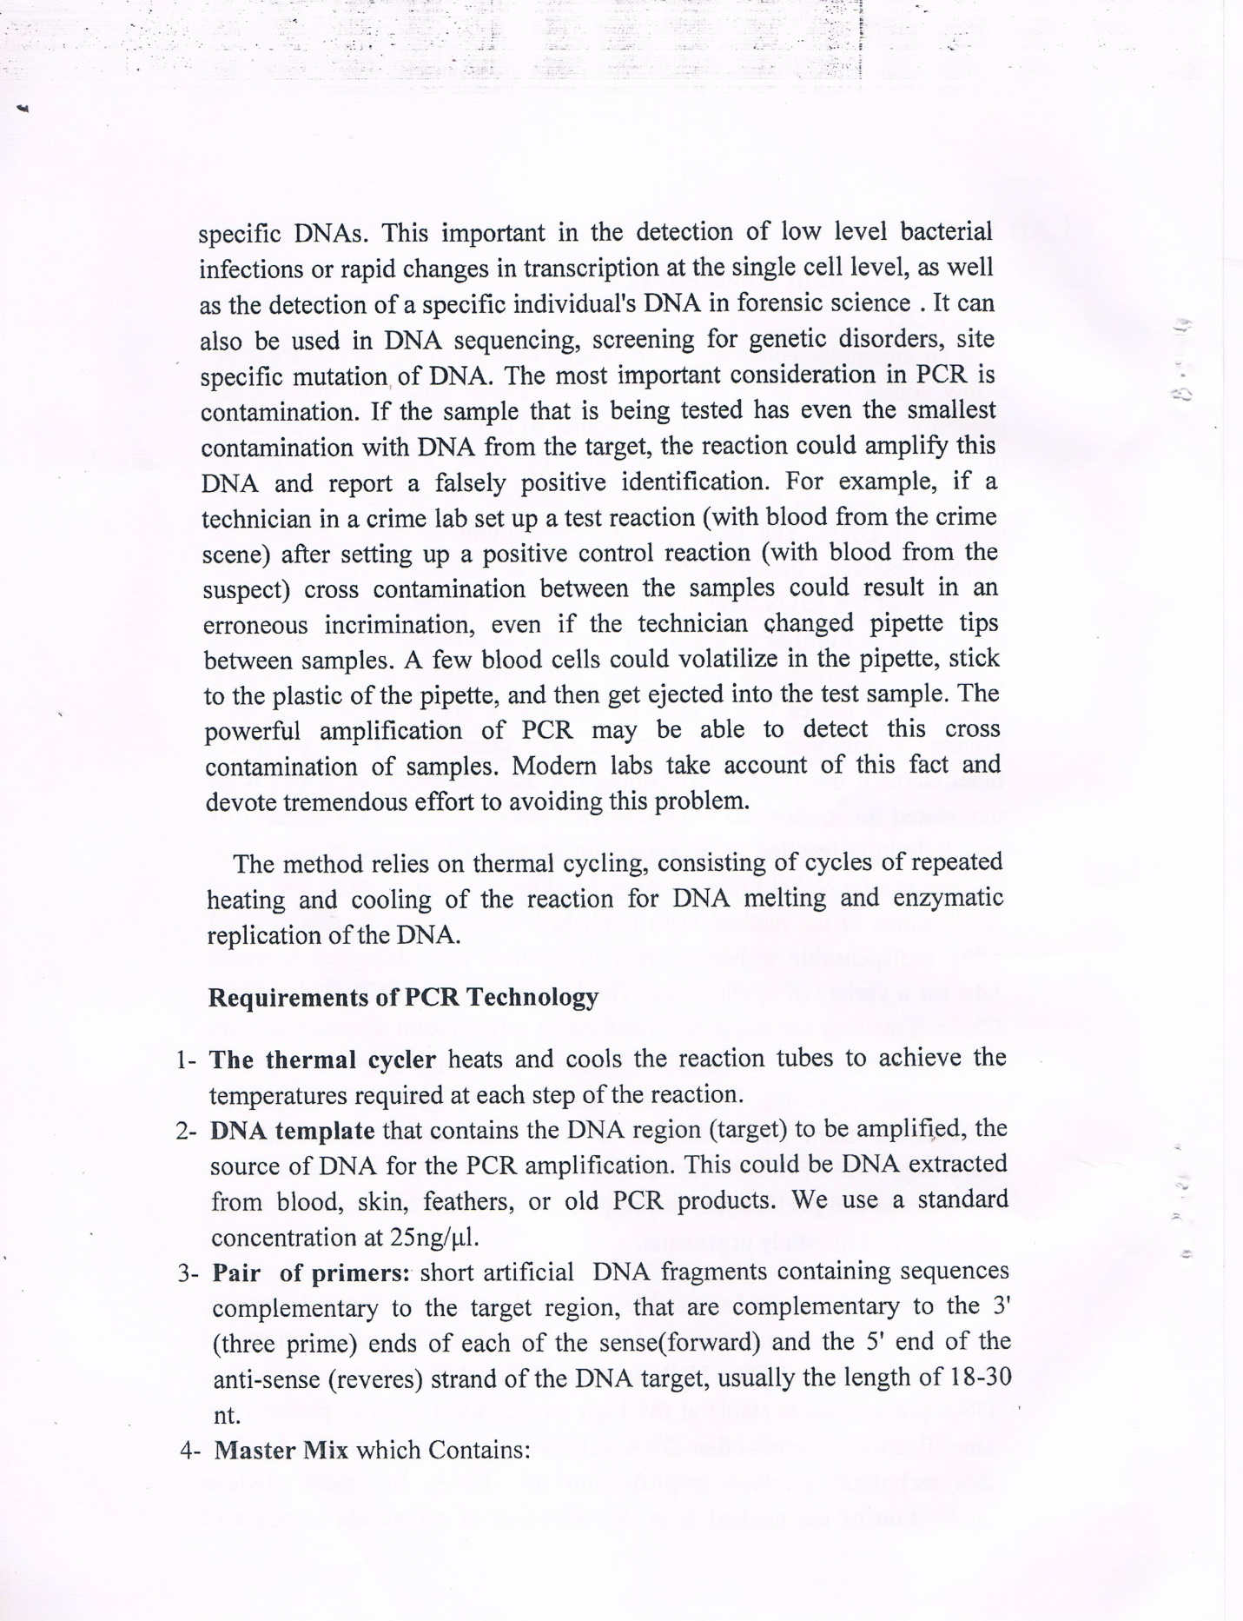

Slide 6
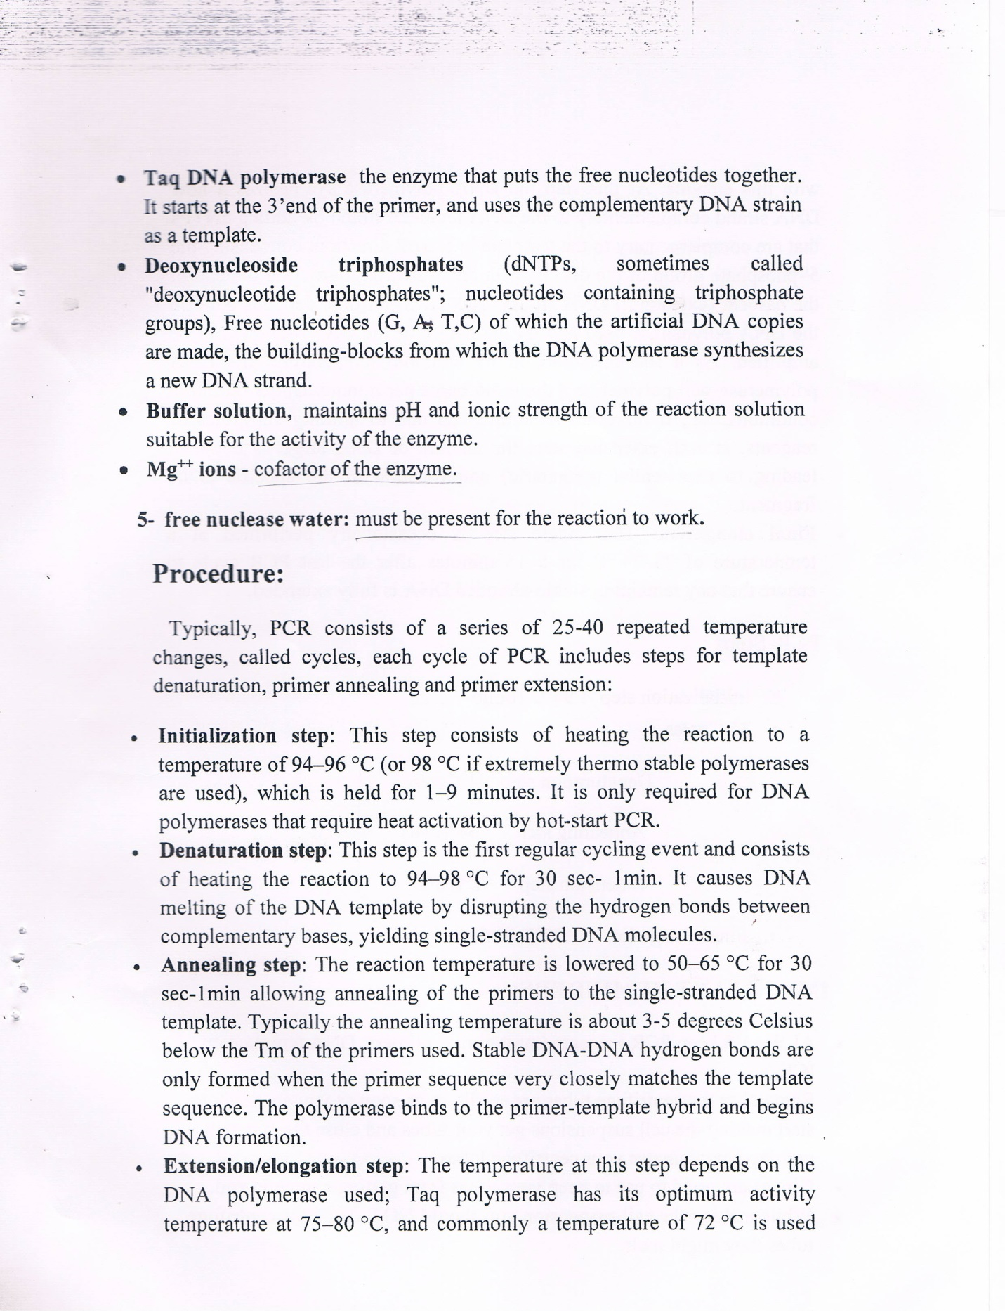

Slide 8
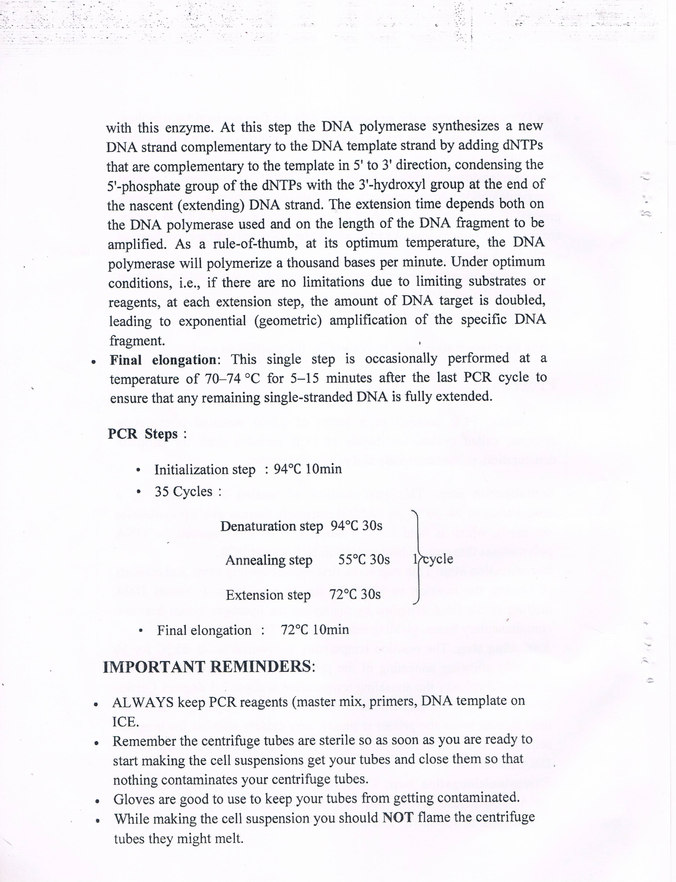

Slide 10
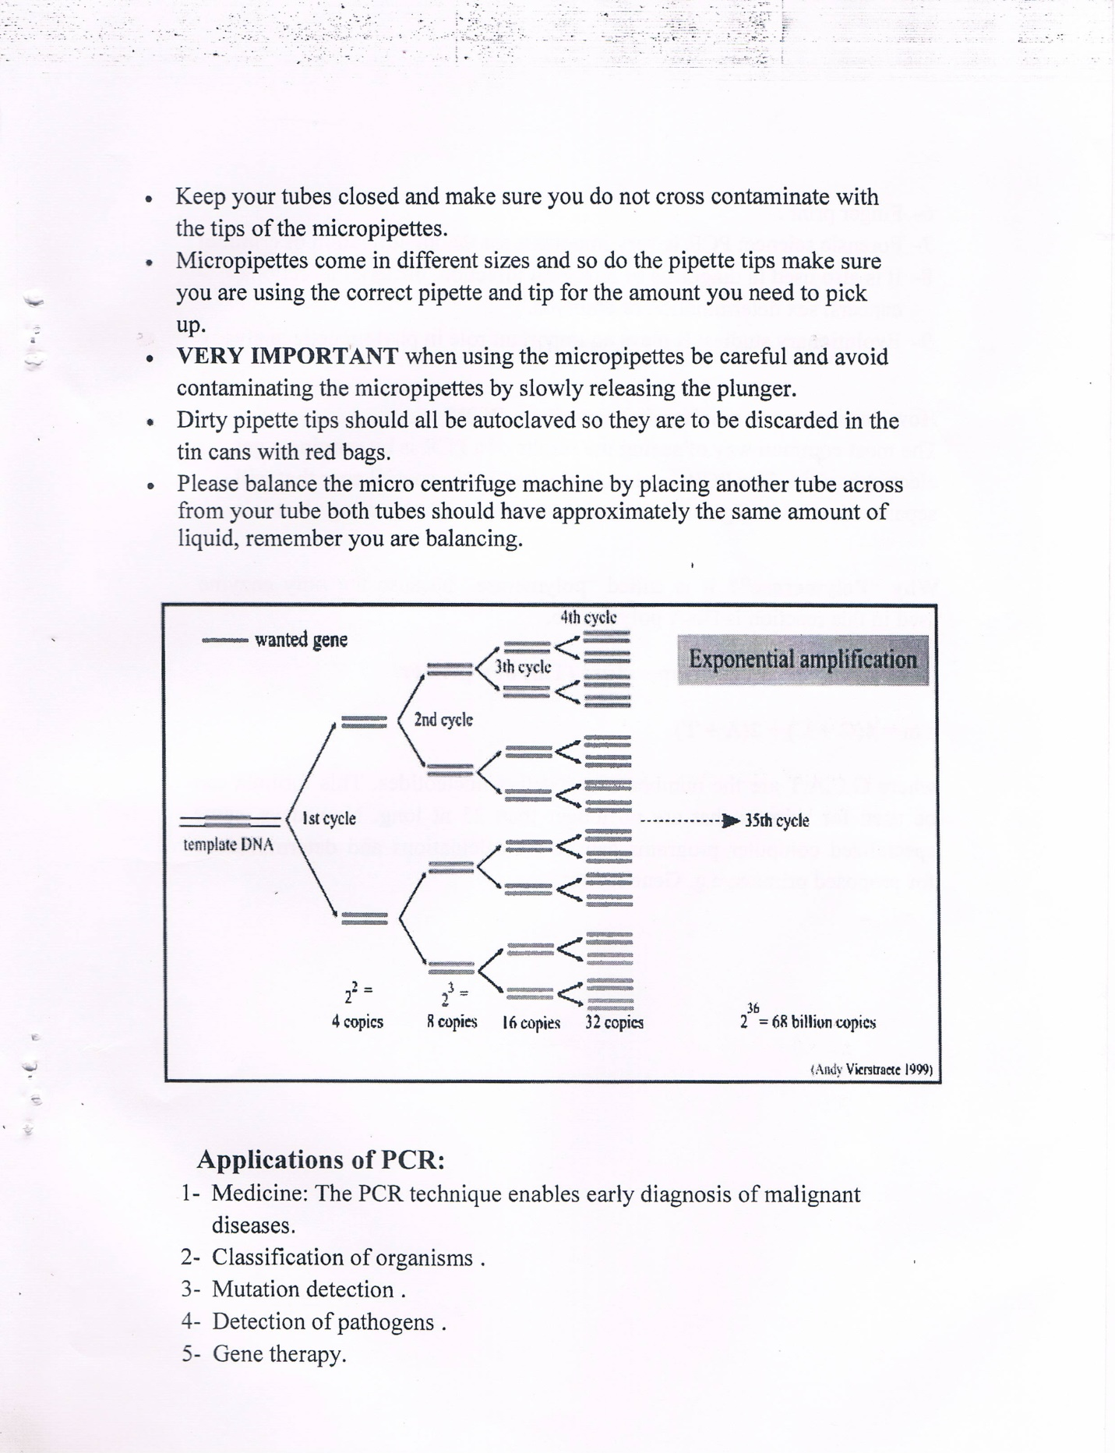

Slide 12
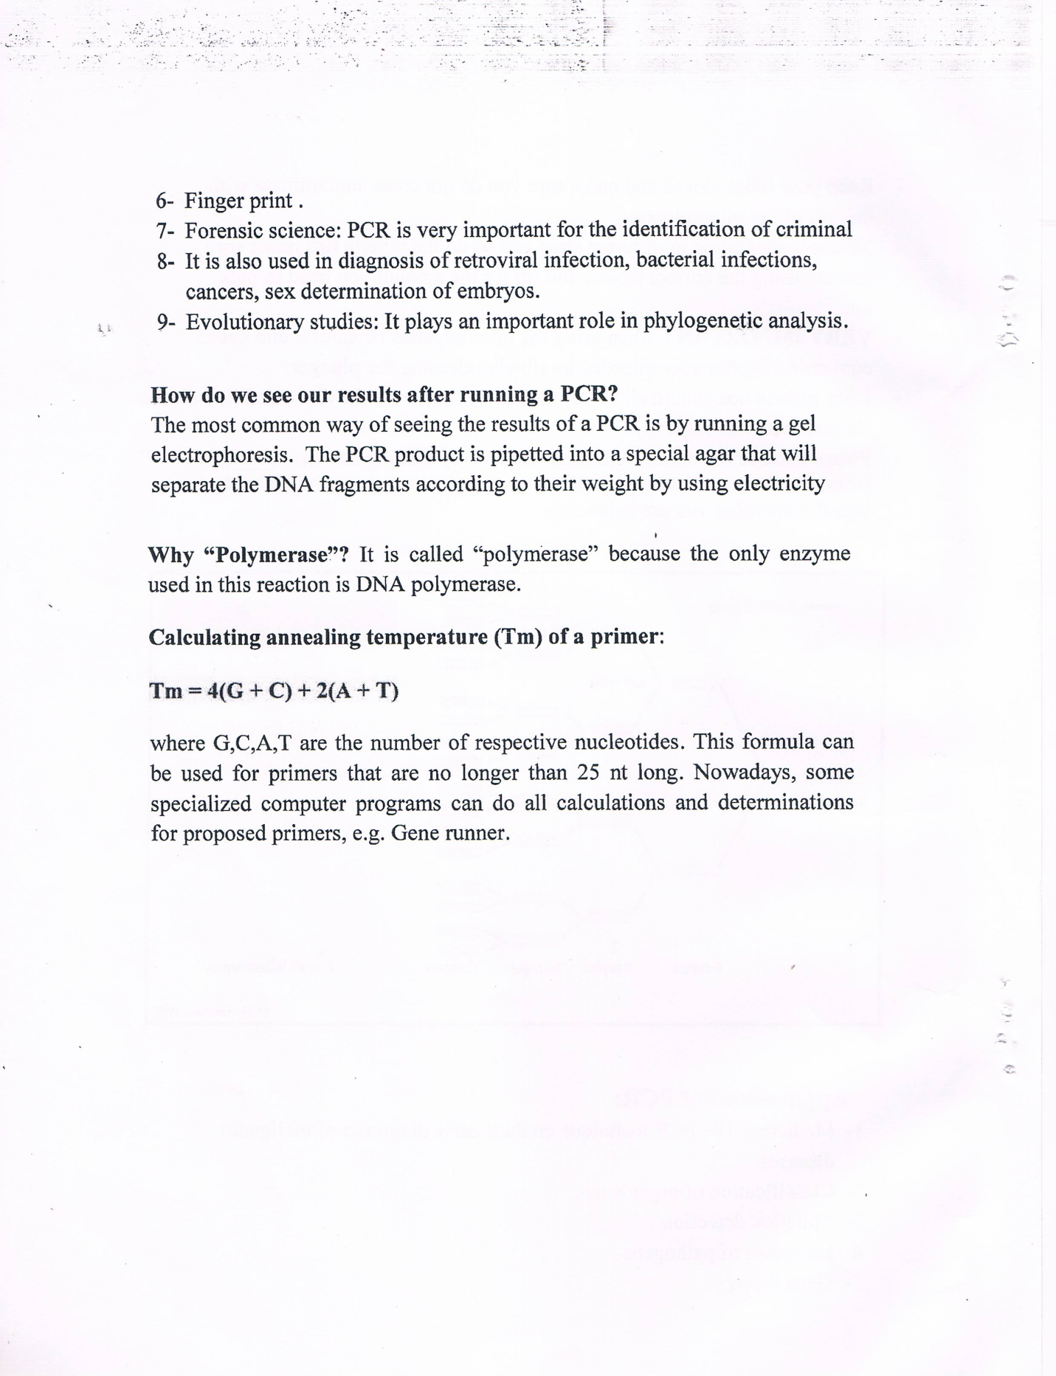

Slide 13

Any Question?

